Slide 1
Regularizations
L1 and L2
Dropout
Call backs
Batch Normalizations
Weight Initializations

Slide 2
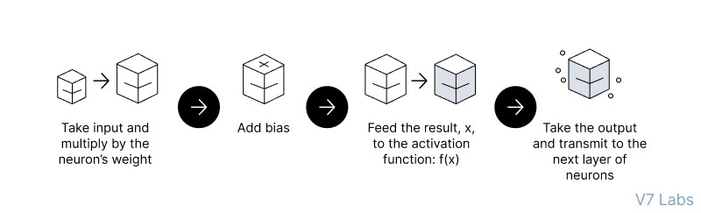
Feedforward Neural Networks (FNN):
the flow of information occurs in the forward direction. The input is used to calculate some intermediate function in the hidden layer, which is then used to calculate an output.
2. Backpropagation
- the weights of the network connections are repeatedly adjusted to minimize the difference between the actual output vector of the net and the desired output vector.
Implement the FNN
https://colab.research.google.com/drive/1z_nL3RcvR1x4uIR88VWEj8Zdr7mYEcQK#scrollTo=keCSdzvOrRmx

Slide 3
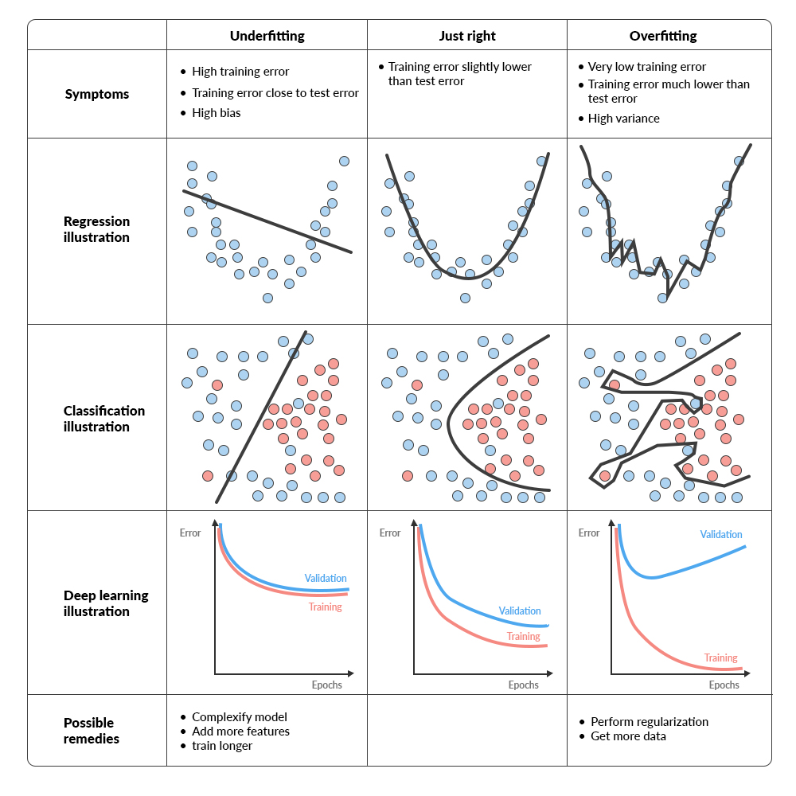

Slide 4
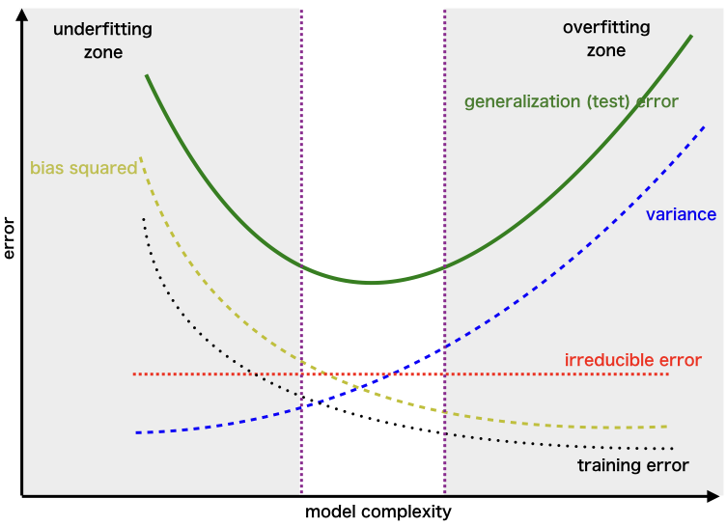
Bias Variance
https://uniathena.com/understanding-bias-variance-tradeoff-balance-model-performance

Slide 5
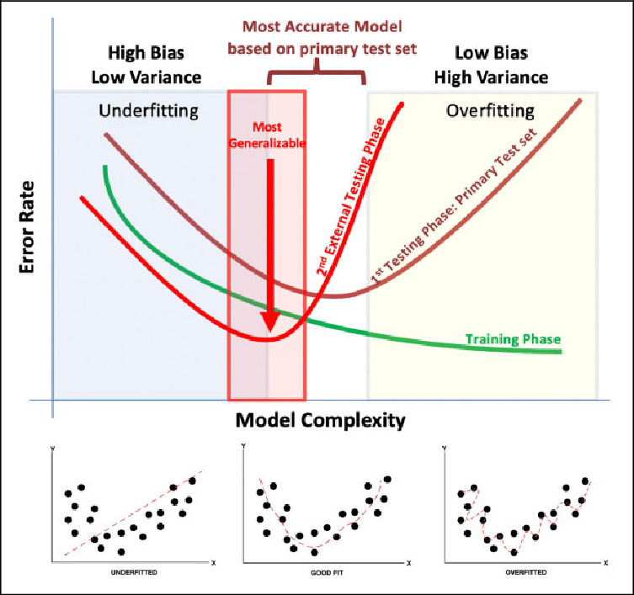

Slide 6
Regularization help reduce Overfitting?

Slide 7
Regularizations
Regularization techniques help improve a neural network’s generalization ability by reducing overfitting. They do this by minimizing needless complexity and exposing the network to more diverse data. This article will cover common regularization techniques:
L1(lasso) and L2(Ridge) regularization
Early stopping
Dropout
CallBack
Data augmentation
Addition of noise
https://zilliz.com/learn/understanding-regularization-in-nueral-networks

Slide 8
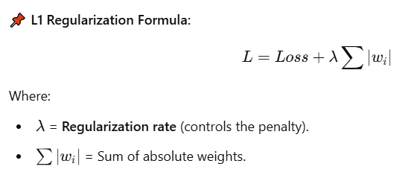
Regularization techniques like L1, L2, and ElasticNet help prevent overfitting by adding a penalty term to the loss function. This keeps model weights small and prevents over-complexity.
1️⃣ L1 Regularization (Lasso Regression)
📖 Definition:
L1 Regularization, also called Lasso (Least Absolute Shrinkage and Selection Operator), adds the absolute values of the weights to the loss function.
✅ Pros:
✔ Encourages sparse models (some weights become zero).
✔ Useful for feature selection (eliminates less important features).
❌ Cons:
❌ Can lead to unstable models when features are correlated.
❌ Not ideal for smooth weight shrinkage.
💻 Code Example (L1 Regularization in TensorFlow/Keras):
from tensorflow.keras.regularizers import l1
model.add(Dense(64, activation='relu', kernel_regularizer=l1(0.01))) # L1 penalty with lambda=0.01

Slide 9
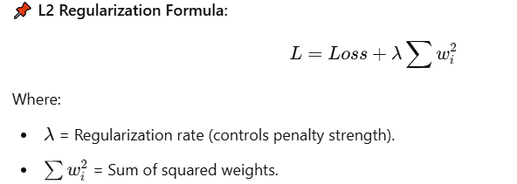
2. L2 Regularization (Ridge Regression)
📖 Definition:
L2 Regularization, also called Ridge Regression, adds the squared values of the weights to the loss function.
✅ Pros:
✔ Encourages smaller weights, preventing overfitting.
✔ Works well when features are correlated.
❌ Cons:
❌ Does not produce sparse models (all weights remain nonzero).
❌ May not be ideal for feature selection.
💻 Code Example (L2 Regularization in TensorFlow/Keras):
python
CopyEdit
from tensorflow.keras.regularizers import l2 model.add(Dense(64, activation='relu', kernel_regularizer=l2(0.01))) # L2 penalty with lambda=0.01

Slide 10
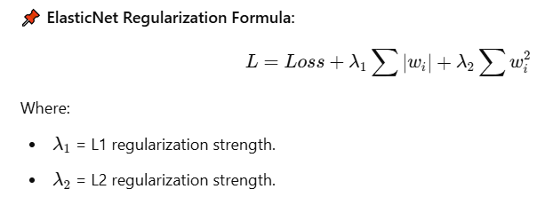
3. ElasticNet Regularization (Combination of L1 & L2)
📖 Definition:
ElasticNet is a hybrid of L1 and L2 regularization. It balances sparsity and smooth weight shrinkage.
📌 ElasticNet Regularization Formula:
✅ Pros:
✔ Provides the best of both L1 and L2.
✔ Works well when features are highly correlated.
❌ Cons:
❌ Requires tuning of both λ1 and λ2​.
💻 Code Example (ElasticNet in TensorFlow/Keras):
from tensorflow.keras.regularizers import l1_l2 model.add(Dense(64, activation='relu', kernel_regularizer=l1_l2(l1=0.01, l2=0.01)))

Slide 11
📌 Regularization Rate (Lambda, λ)
The regularization rateλ\lambdaλ controls how much penalty is applied to large weights:
Low λ → Less penalty (model can overfit).
High λ → More penalty (model can underfit).
Optimal λ → Found using hyperparameter tuning.
📌 Which One Should You Use?
If you want feature selection → L1 (Lasso).
If you want smooth weight shrinkage → L2 (Ridge).
If your data has correlated features → ElasticNet.

Slide 12
Why Use Absolute Value in L1 (Lasso)?
L1 Regularization adds the sum of the absolute values of weights to the loss function:
L=Loss+λ∑∣wi∣i​∣
📌 Key Properties of Absolute Value |w|:
The derivative of |w| is constant (except at zero):
If w>0w > 0w>0, derivative = +1+1+1.
If w<0w < 0w<0, derivative = −1-1−1.
If w=0w = 0w=0, derivative is undefined, but typically set to 0.
📌 Effect on Weights:
L1 applies equal pressure on all nonzero weights, regardless of size.
This forces some weights to become exactly zero, leading to feature selection (sparse models).
💡 Intuition: Imagine you want to shrink some weights to zero while allowing others to stay significant. The absolute value enforces this by applying a constant force that drives small weights to exactly zero.
🔍 Example Weight Update (Gradient Descent in L1):
If a weight is positive, it gets decreased.
If a weight is negative, it gets increased.
If a weight is small, it is forced to zero (sparse model).

Slide 13
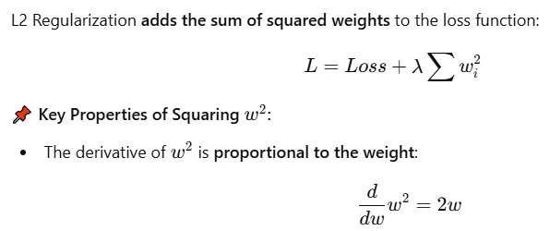
2 Why Use Squaring in L2 (Ridge)?
This means larger weights shrink faster, while smaller weights shrink more slowly.
📌 Effect on Weights:
L2 applies larger penalties to bigger weights, making the weight distribution smooth.
Unlike L1, L2 does not force weights to exactly zero, but shrinks them uniformly.
💡 Intuition: Think of squaring as a way to smoothly reduce large values rather than setting some to zero. It is like a spring that pulls weights back towards zero in a continuous way.
🔍 Example Weight Update (Gradient Descent in L2):
If a weight is large, the gradient (2w) is big, so it shrinks quickly.
If a weight is small, the gradient (2w) is small, so it shrinks slowly.
Why L1 Uses |w| and L2 Uses w^2?
| Property | L1 Regularization (|w|) | L2 Regularization (w^2) |
|----------- |---------------- |----------------|
| Penalty Type | Absolute value | Squared value |
| Effect on Weights | Some weights shrink to zero (sparse) | Weights shrink smoothly (small, but nonzero) |
| Best For | Feature selection (removes unnecessary weights) | Preventing overfitting (reduces large weights) |
| Weight Shrinkage | Equal shrinkage for all weights | Proportional shrinkage (larger weights shrink more) |
4 Why Not Swap Them?
If we used L1 with squared values, it wouldn't create sparsity (zero weights).
If we used L2 with absolute values, the gradient wouldn't smoothly reduce large weights.
The current setup is mathematically optimal for their respective goals.

Slide 14
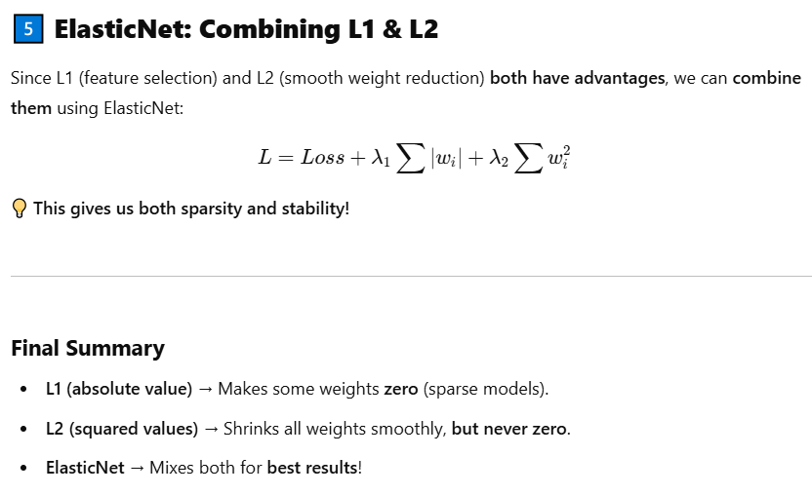

Slide 15
Reference
https://www.kaggle.com/code/sid321axn/regularization-techniques-in-deep-learning
https://www.pinecone.io/learn/regularization-in-neural-networks/
https://www.analyticsvidhya.com/blog/2018/04/fundamentals-deep-learning-regularization-techniques/#h-l2-amp-l1-regularization
https://www.geeksforgeeks.org/regularization-in-machine-learning/
https://dotnettutorials.net/lesson/dropout-layer-in-cnn/

Slide 16
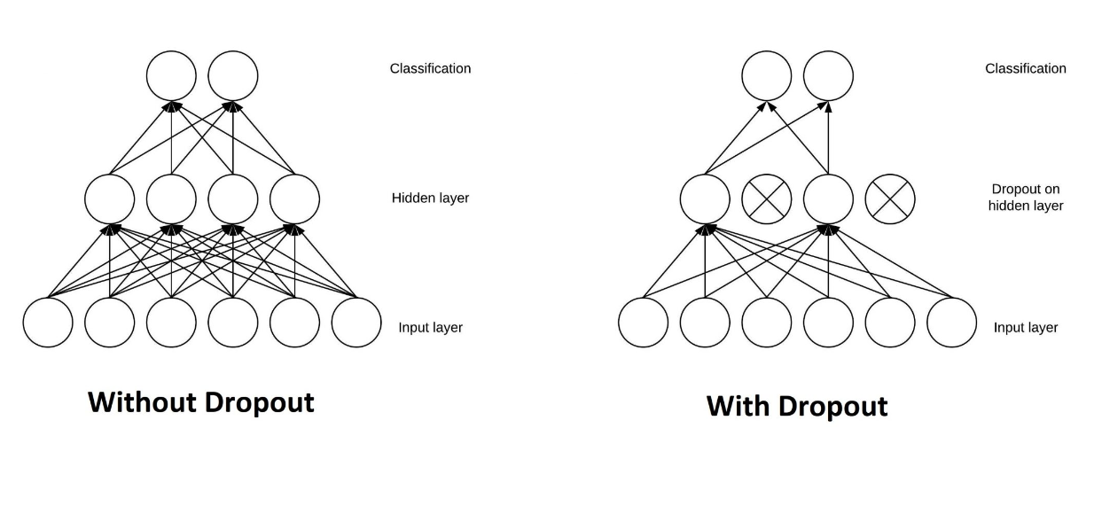
2. Dropout
What is a dropout in neural networks?
Dropout helps prevent overfitting by randomly nullifying outputs from neurons during the training process. This encourages the network to learn redundant representations for everything and hence, increases the model's ability to generalize.
self.dropout = nn.Dropout(0.25)
https://www.analyticsvidhya.com/blog/2022/08/dropout-regularization-in-deep-learning/

Slide 17
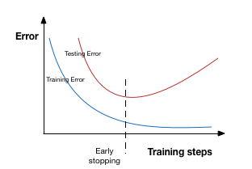
EarlyStop
Early stopping is a kind of cross-validation strategy where we keep one part of the training set as the validation set. When we see that the performance on the validation set is getting worse, we immediately stop the training on the model. This is known as early stopping.
In the above image, we will stop training at the dotted line since after that our model will start overfitting on the training data.
In keras, we can apply early stopping using the callbacks function. Below is the implementation code for it.I have applied early stopping so that it will stop immendiately if validation error will not decreased after 3 epochs.

Slide 18
fromkeras.callbacksimportEarlyStopping
earlystop=EarlyStopping(monitor='val_acc',patience=3)
epochs=20#
batch_size=256

Slide 19
Call backs
Model Checkpoint
Early stoping

Slide 20
Batch Normalizations

Slide 21
Weight Initializations
Xavier/Glorat And He Weight Initialization in Deep Learning
Exponentially Weighted Moving Average or Exponential Weighted Average

Slide 22
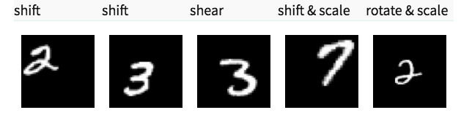
Data Augmentation
The simplest way to reduce overfitting is to increase the size of the training data. In machine learning, we were not able to increase the size of training data as the labeled data was too costly.
But, now let’s consider we are dealing with images. In this case, there are a few ways of increasing the size of the training data – rotating the image, flipping, scaling, shifting, etc. In the below image, some transformation has been done on the handwritten digits dataset.

Slide 23
fromkeras.preprocessing.imageimportImageDataGenerator
datagen=ImageDataGenerator(featurewise_center=False,
# set input mean to 0 over the datasetsamplewise_center=False,# set each sample mean to 0featurewise_std_normalization=False,# divide inputs by std of the datasetsamplewise_std_normalization=False,# divide each input by its stdzca_whitening=False,# apply ZCA whiteningrotation_range=10,# randomly rotate images in the range (degrees, 0 to 180)zoom_range=0.1,# Randomly zoom image width_shift_range=0.1,# randomly shift images horizontally (fraction of total width)height_shift_range=0.1,# randomly shift images vertically (fraction of total height)horizontal_flip=False,# randomly flip imagesvertical_flip=False)# randomly flip imagesdatagen.fit(x_train)

Slide 24
Model Expainlibility
LIME
SHAPY

Slide 25
HyperParameter tuning
keras tunier

